Slide 1
DBMS PROJECT
Hotel Reservation and Billing system
N.Pragna -207147
Pranjal Chaudhary -207155
Tanmay Vaishnav -207277

Slide 2
ER diagram
An Entity Relationship (ER) Diagram is a type of flowchart that illustrates how “entities” such as people, objects or concepts relate to each other within a system.
ER Diagrams are most often used to design or debug relational databases in the fields of software engineering, business information systems, education and research
Also known as ERDs or ER Models, they use a defined set of symbols such as rectangles, diamonds, ovals and connecting lines to depict the interconnectedness of entities, relationships and their attributes.
. Following is the Entity-relationship model for our hotel reservation and billing system database. It contains six entity sets and five relationship sets. All entities are strong entities and have one primary key attribute(underlined)

Slide 3
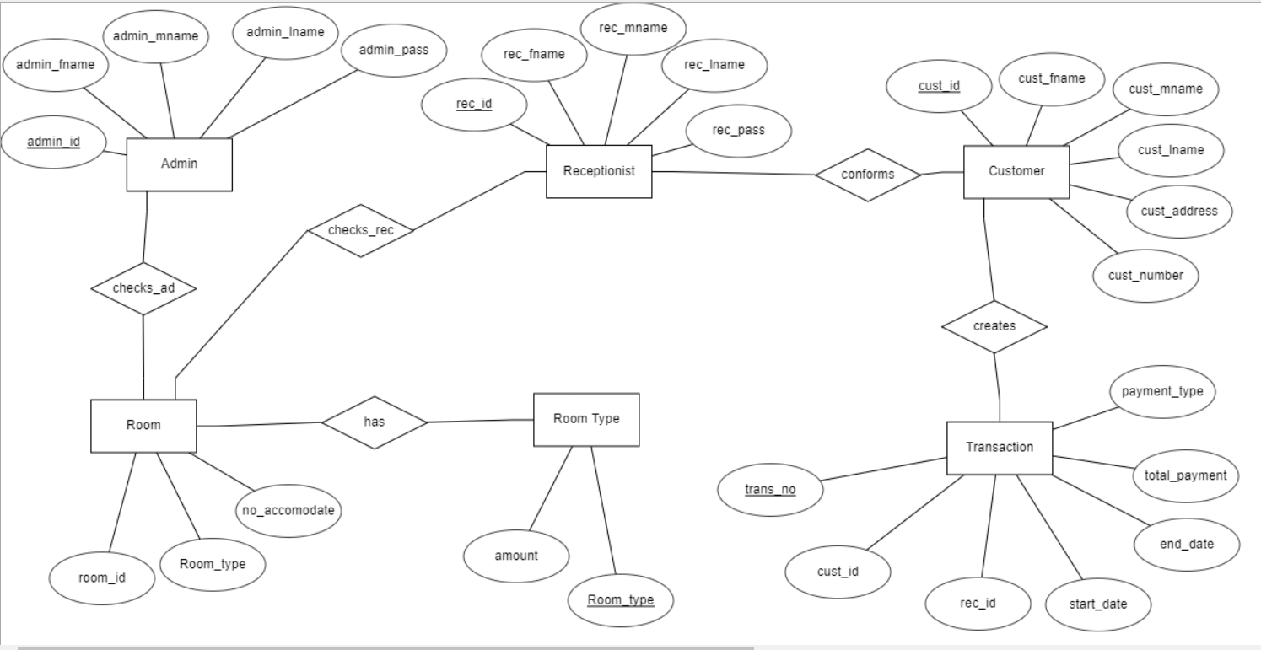

Slide 4
ENTITY sets
Following are the entities in er diagram
Admin (admin_id,admin_fname,admin_mname, admin_lname,admin_pass) Primary key :- admin_id
Room (room_id,room_type,no_accomodate) Primary key :- room_id
Room_type (room_type,amount) Primary key :- room_type
Receptionist(rec_id,rec_fname,rec_mname, rec_lname,rec_pass) Primary key :- rec_id
Customer (cust_id,cust_fname,cust_mname, cust_lname,cust_address,cust_number) Primary key :- cust_id
Transaction (trans_no,cust_id,rec_id,start_date end_date,total_payment,payment_time) Primary key :- trans_no Foriegn keys :- cust_id,rec_id

Slide 5
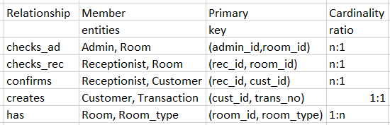
Relationship sets
Following table describes all the relationships existing between various tables in er diagram. All the relationships are of binary degree .

Slide 6
ER to Relational model Conversion
For all the 1:n (or n:1) relationships we can choose the entity on the n-side and include a copy of the primary key of the entity on the 1-side. This field becomes a foreign key in the table on the nside
This will be applicable to all the relationships except creates which is 1:1.
For 1:1 relationship we can copy the primary key from the first table into the second table , it becomes a foreign key in the second table.
Applying the conversions we get the following relational model schema.

Slide 7
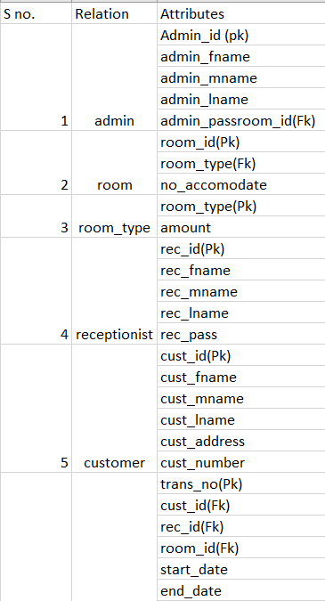


Slide 8
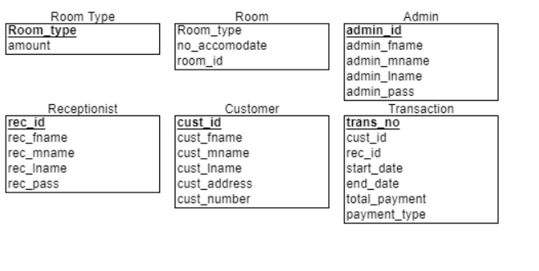
Schema
A schema can be defined as the design of a database. The overall description of the database is called the database schema.

Slide 9
Tables creation
1)Room_Type Table
create table room_type(
room_type varchar(10),
amount number,
Primary key(room_type)
);
insert into room_type values ('SINGLE',10000);
insert into room_type values ('DOUBLE',15000);
insert into room_type values ('TRIPLE',20000);
insert into room_type values ('QUAD',25000);
select * from room_type;
-AND INSERTION

Slide 10
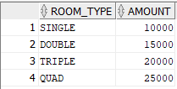

Slide 11
2) Room Table:
drop table room;
create table room(
room_id varchar(10),
room_type varchar(10),
no_accomodate number,
primary key(room_id),
Foreign key(room_type) references
room_type(room_type)
);
insert into room values (‘R101','SINGLE',1);
insert into room values (‘R102','DOUBLE',2);
insert into room values (‘R103','SINGLE',1);
insert into room values (‘R104','QUAD',4);
insert into room values (‘R105','TRIPLE',3);
insert into room values (‘R106','DOUBLE',2);
insert into room values (‘R107','SINGLE',1);
insert into room values (‘R108','QUAD',4);
insert into room values (‘R109','TRIPLE',3);
insert into room values (‘R110','TRIPLE',3);
select * from room;

Slide 12
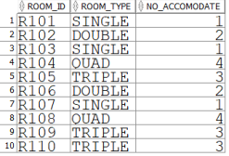

Slide 13
3)Admin Table:
create table admin(
admin_id varchar(10),
admin_fname varchar(10),
admin_mname varchar(10),
admin_lname varchar(10),
admin_pass varchar(10),
room_id varchar(10),
primary key (admin_id),
foreign key (room_id) references room
(room_id));
insert into admin values('b101','KAPIL','KUMAR','SHARMA','A101R101','A101');
insert into admin values ('b102','REKHA','KUMARI','MEENA','A102R102','A102');
insert into admin values ('b103','RAJA','BANA','RAJPUT','A103R103','A103');
insert into admin values ('b104','SANTOSH','KUMAR','SHARMA','A104R104','A104');
insert into admin values ('b105','TOM',null,'ALFRED','A105R105','A105');
insert into admin values ('b106','PANKAJ','KUMAR','GOYAL','A106R106','A106');
insert into admin values ('b107','RINTU','KUMARI',null,'A107R107','A107');
insert into admin values ('b108','VISHAL',null,null,'A108R108','A108');
insert into admin values ('b109','ASHOK',null,'BHINDE','A109R109','A109');
insert into admin values ('b110','RAHUL','KUMAR',null,'A110R110','A110');

Slide 14
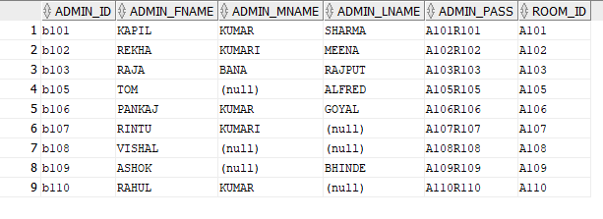

Slide 15
4)Receptionist table:
create table receptionist(
rec_id varchar(10),
rec_fname varchar(10),
rec_mname varchar(10),
rec_lname varchar(10),
rec_pass varchar(10),
primary key(rec_id));
insert into receptionist values
('REC101','MAHENDRE','SINGH','BAKKA','R101M
SB');
insert into receptionist values
('REC102','RAKHI','KUMARI',null,'R102RK');
insert into receptionist values
('REC103','SHANKAR','SINGH','RAJPUT','R103SK
R');
insert into receptionist values
('REC104','HAZEL',null,'LOCKWOOD','R104HL');
insert into receptionist values
('REC105','KRISHNA','SINGH','PATEL','R105KSP'
);
select * from receptionist;

Slide 16
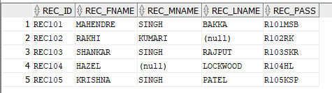

Slide 17
5) Customer Table :
create table customer(
cust_id varchar(10),
cust_fname varchar(10),
cust_mname varchar(10),
cust_lname varchar(10),
cust_address varchar(20),
cust_number number(10),
primary key(cust_id));
insert into customer values('C101','MUKESH','SINGH','GAUR','1011
Malesuada Road',7458899550);
insert into customer values('C102','HARRISON',null,'Mcguire','574-8633 Arcu
Street',7556899550);
insert into customer values('C103','RAJ','KUMAR','PATEL','9631 Semper
Ave',9835889955);
insert into customer values('C104','KAJAL',null,'ROY','Santa Barbara
M4',7458899578);
insert into customer values('C105','PRITI',null,'PATIDAR','Sedalia Utah
53700',9958899550);
insert into customer values('C106','NELL','JOHN','FRED','Astoria NJ 66309',7446599550);
select * from customer;

Slide 18
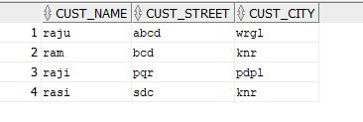

Slide 19
create table transaction(
trans_no int,
cust_id varchar(10),
rec_id varchar(10),
room_id varchar(10),
start_date date,
end_date date,
total_paytment int ,
payment_time varchar(10),
primary key (trans_no)
foreign key(cust_id) references
customer(cust_id)
foreign key(rec_id) references
receptionist(rec_id)
foreign key(room_id) references
room(room_id)
);

Slide 20
insert into transaction values(102101,'C102','REC101','A101','10-01-2021','12-
01-2021',20000,'20:01');
insert into transaction values(101101,'C101','REC101','A103','08-01-2021','8-
01-2021',10000,'06:45');
insert into transaction values(103103,'C103','REC103','A102','02-02-2021','03-
02-2021',15000,'7:30');
insert into transaction values(104102,'C104','REC102','A106','05-02-2021','08-
02-2021',45000,'18:04');
insert into transaction values(105104,'C105','REC104','A105','10-02-2021','12-
02-2021',40000,'19:50');
insert into transaction values(106105,'C106','REC105','A109','11-02-2021','12-
02-2021',15000,'3:41');
insert into transaction values(102104,'C102','REC104','A106','11-02-2021','13-
02-2021',40000,'5:59');
insert into transaction values(104102,'C104','REC102','A101','12-02-2021','12-
02-2021',10000,'10:15');
insert into transaction values(102103,'C102','REC103','A108','15-02-2021','16-
02-2021',40000,'8:00');
insert into transaction values(106101,'C106','REC101','A106','15-02-2021','15-
02-2021',15000,'18:30');
insert into transaction values(103102,'C103','REC102','A102','17-02-2021','18-
02-2021',30000,'5:06');
insert into transaction values(104104,'C104','REC104','A104','18-02-2021','19-
02-2021',40000,'12:00');

Slide 21
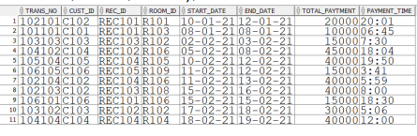

Slide 22


